Slide 1
Basic Concepts
Adrian Streitz, Johannes Rank, Borys Levkovskyi

Slide 2
Prerequisites
Experience with ABAP Workbench and Eclipse

Slide 3
Agenda
Data types and data declaration
Important instructions
Background processing
Debugging

Slide 4
I. Data types and data declaration Data types
Data type
predefined
(P, I, F, C, N, D, T, X)
user defined
elementary
complex
structured
table type
Source: Following SAP AG

Slide 5
I. Data types and data declaration Predefined data types in ABAP
Data type | Sense | Initial value | Possible values | Valid field length
d | Date | 00000000 | 20161031 (31.10.2016) | Max. 8 characters
t | Time | 000000 | 235900 (23:59 Uhr) | Max. 6 characters
i | Integer | 0 | 987654321 | Max. 4 bytes
f | Float | 0 | -1,860 | Max. 8 bytes
String | String | „“ | „Hello World!“ | variable
Xstring | Byte | „“ | Hexadecimal characters 0-9, A-F | variable
p | Packed number | 0 | 1,43 (Length of p = 2) | Max. 16 bytes
n | Numerical text | 00 … 0 | Alphanumeric characters; Valid values are only the digits 0 to 9 | Max. 65535 bytes
c | Character | <SPACE> | Alphanumeric characters | Max. 65535 bytes
x | Byte (hex) | X’0…0‘ | Hexadecimal characters 0-9, A-F | Max. 65535 bytes

Slide 6

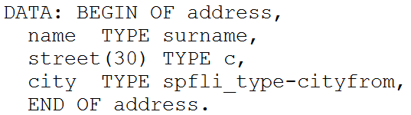


I. Data types and data declaration Data declaration
Elemental field definition:
Structured data object:
Internal table:

Slide 7


I. Data types and data declaration Data declaration
Constants:
Parameters:

Slide 8
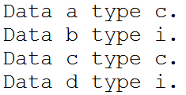

I. Data types and data declaration Data declaration
Instead of defining every single data/constant/parameter:
Use:

Slide 9
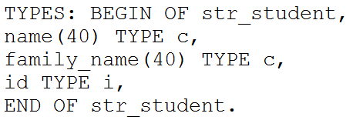
I. Data types and data declaration Definition of own data types
Definition of completely new data types
New data types can be derived from existing data types:
Definition of one’s own data type:

Slide 10
I. Data types and data declaration Definition of own data types
Declaration of a new structure:
Access to the structure:

Slide 11
I. Data types and data declaration System Fields
Structure SYST contains many system variables from the SAP system
Structure can be viewed in Data Dictionary (SE11) via data type SYST
Field | Sense
Sy-subrc | Returncode of last instruction
Sy-date | Current date and time
Sy-uname | Username of the current user
Sy-host | Name of application server
Sy-langu | Current system language
Sy-dbsys | Name of database server
Sy-tcode | Current transaction code
Sy-index | Loop index
Sy-client | Current client number

Slide 12
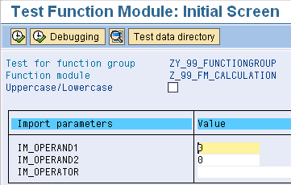
I. Data types and data declaration Selection screens
Selection screens simplify interaction with user
Selection screens always have Dynpro number 1000
Selection screens are generated automatically when keyword Parameters is used in source code
Parameters is also used for variable declaration

Slide 13
Now you know the data types and data declaration in ABAP.
To consolidate your knowledge, you can do task 1 and 2 of the Basic Concepts exercise.

Slide 14
II. Important instructions Important instructions and control structures
Data manipulation
Data object conversion
Control structures
Loops
Branching conditionally

Slide 15
II. Important instructions Data manipulation
Assign: MOVE f TO g or g = f
Numeric: ADD n TO m or m = m + n
String: CONCATENATE, SPLIT, SEARCH, REPLACE, CONDENSE, TRANSLATE …
Logical:
For all data types: =, <>, <, >, <=, >=
For character like types: CO (contains only), CN (contains not only), CA (contains any) …
For byte like types: BYTE-CO, BYTE-CN, BYTE-CA …
For bit patterns: O (Ones), Z (Zeros), M (Mixed)

Slide 16
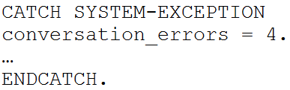
II. Important instructions Data object conversion
If it is possible to migrate values from one data type to another, the SAP system does it automatically
Static incompatible: between date and time
Dynamic incompatible: between char ‘1234hello’ and integer
Dynamic compatible: between char ‘1234’ and integer 1234
Exceptions can be caught

Slide 17
II. Important instructions Control structures: loops
WHILE – ENDWHILE:
WHILE <logical expression>.
<instructions>
ENDWHILE.
DO – ENDDO
DO n TIMES.
<instructions>
ENDDO.
Sy-index: returns the current loop index and refers to the current loop (in case of nested loops)

Slide 18
II. Important instructions Control structures: branching
IF:
IF <logical expression>.
<instruction 1>
[ELSEIF <logical expression>.]
[<instruction 2>]
[ELSE.]
[<instruction 3>]
ENDIF.

Slide 19
II. Important instructions Control structures: branching
CASE:
CASE <data object>.
[WHEN <value 1>.
[<instruction 1>.
[WHEN <value 2>.
[<instruction 2>.
[WHEN OTHERS.
[<instruction 3>.
ENDCASE.

Slide 20
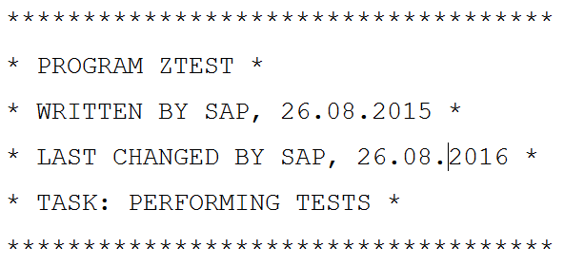
II. Important instructions Comments
Commenting by the preceding sign ´*´:
Commenting by ‘ “ ‘ at any position in the line:
only valid if at the beggining of the line
use CTRL + 7 in Eclipse to comment automatically

Slide 21
Now you know important instructions in ABAP.
To consolidate your knowledge, you can do task 3 of the Basic Concepts exercise.

Slide 22
III. Background processing Background processing vs. Foreground processing
Usual programs use dialog work processes
Long running programs should always run in the background
All ABAP programs can be scheduled as background jobs in TA SM36
For ABAP programs with a user interface you can predefine the user input by using variants

Slide 23
IV. Debugging Why debugging?
Sooner or later even professional programmers have to deal with software bugs
Often programmers assume certain preconditions like:
Variable x = 16
In an if-statement the else-branch gets executed
How to verify that the preconditions are met? → Debugging
Debugging helps to answer following questions:
What is the bug / software fault?
Where does the bug occur?
How is it caused?
→ It helps getting a better understanding about software bugs

Slide 24
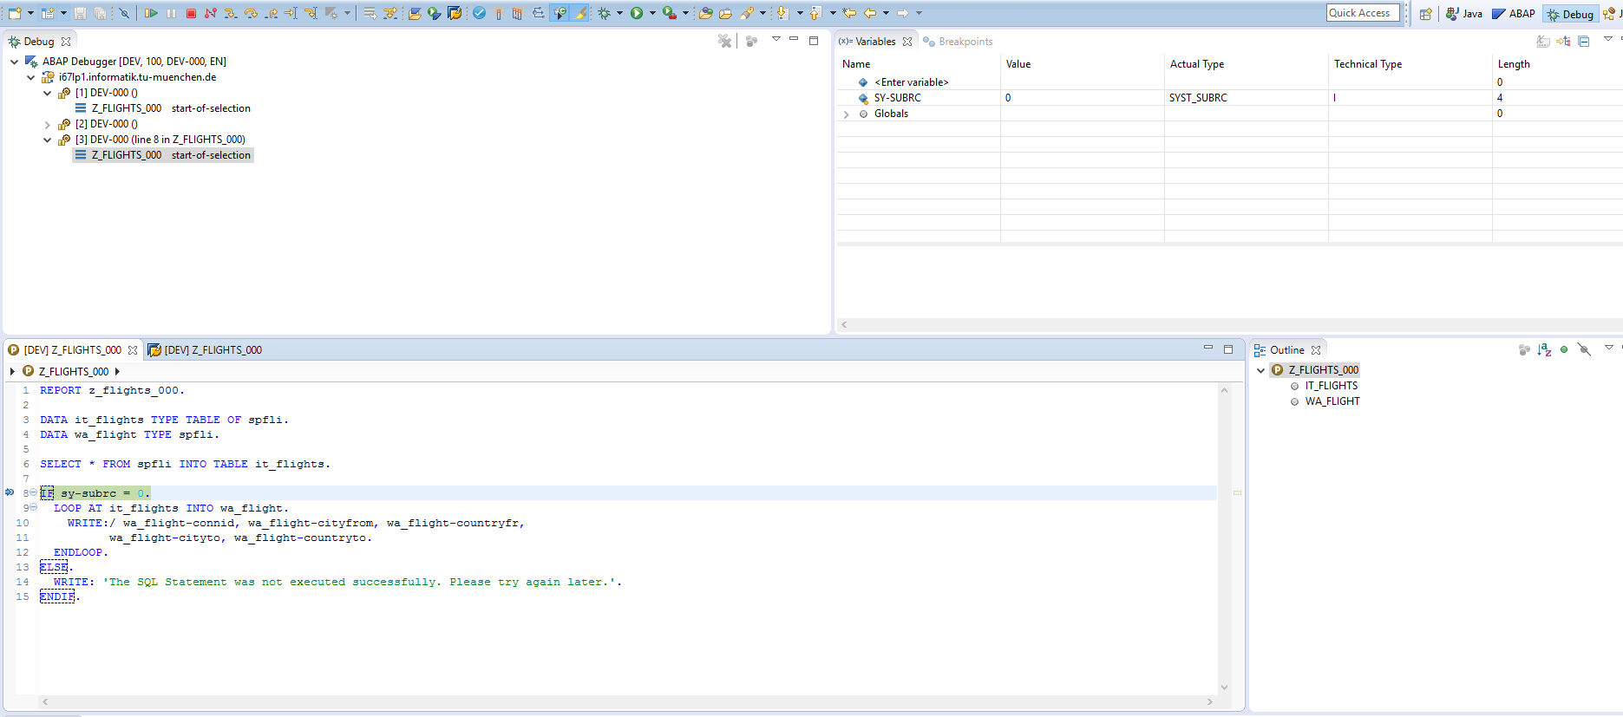

IV. Debugging Debugging ABAP in Eclipse
Eclipse offers a debugging perspective
Monitor the call stack
Monitor and assign variables
View your source code

Slide 25
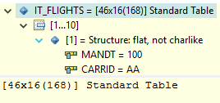
IV. Debugging Working with the Eclipse Debugger
Set a breakpoint in your source code
Control the debugger
Run the program again – it will stop at the next breakpoint
Terminate the program
Step deeper into the source code
Do one more step (step over)
Elements of the debugger
Breakpoint
Current execution marker
View contents of variable (e.g. by mouseover)

Slide 26
Now you know how to debug your ABAP program in Eclipse.
To consolidate your knowledge, you can do task 4 of the Basic Concepts exercise.

Slide 27
Check your knowledge

Slide 28

Check your knowledge
Which are valid data types in ABAP.
□ Integer (i) □ Double (d) □ Numerical text (n) □ Long (l)
Following code works flawless (explain your answer!).
□ True □ False
What to do first when doing an ABAP exercise and your program produces an unexpected output: □ Ask your instructor □ Do some research on Google □ Use the debugger

Slide 29
Solution

Slide 30
Check your knowledge
Which are valid data types in ABAP.
☒ Integer (i) □ Double (d) ☒ Numerical text (n) □ Long (l)
Following code works flawless (explain your answer!).
□ True ☒ False
See slide 16. To correct the code either change the type of the variable to ‘c’ or set the value to ‘123’
What to do first when doing an ABAP exercise and your program produces an unexpected output: □ Ask your instructor □ So some research on Google ☒ Use the debugger

